Slide 1


What is Happening in
Our Schools?
July 2018
Mommy Lobby AZ
Presenter- Jennifer Reynolds

Slide 2

Why is school choice so popular?
Public district schools are not the only option anymore with charter schools, private schools, parochial schools, home schooling, and on-line schooling. Arizona has many options for parents.
Parents want choices on where to send our children to school that best matches our family values; a curriculum rich in our founding principles; career opportunities after graduation or a school that prepares our students for college (Dual enrollment, trade courses, etc.); we want teachers that are experts in content not pedagogy; etc.
Parents are tired of indoctrination happening in schools promoting far-left ideology. We do not want our children data-mined or tracked without our consent.
State-wide assessments (AzMERIT) or nationally-recognized assessments (NAEP, ACT, SAT, etc.) are not the only way to measure student success.
Parents want our voices to be heard on how our children are educated- we want local control over education!

Slide 3

Why is home schooling so popular?
Parents are moving to home schooling because they have done their homework and do not like the curriculum that is being taught- often it is promoting far-left ideology.
Common Core curriculum mandates and tests in the nation’s public schools, and many charter and private schools, has driven many parents to homeschool.
Many parents have found that their student cannot successfully work at the academic level they are occupying, much less at institutions of higher learning and taking challenging academics- the deliberate dumbing-down of America! This is due to poor standards and curriculum not teaching our students the basics skills to succeed.
Planned parenthood sex education, non-traditional family values, etc., is being promoted in our schools through curriculum from the far-left publishers.

Slide 4
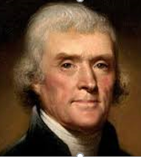
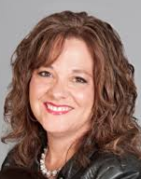
Where is God in Education? http://krisannehall.com/in-context-separation-of-church-and-state/
God in education is nowhere to be found, unless at a parochial school, due to the misinterpretation of the phrase in Thomas Jefferson’s letter to the Danbury Baptists in 1802 when he was elected as president.
Our court systems have failed America with their rulings misapplying this phrase “separation of church and state.”
When Thomas Jefferson was elected president, the Danbury Baptists wanted to encourage their new president to continue to fight for religious liberty. President Jefferson’s response to their letter of congratulations was, “I contemplate with sovereign reverence that act of the whole American people which declared that their legislature should ‘make no law respecting an establishment of religion or prohibiting the free exercise thereof,’ thus building a wall of separation between Church and State.”
“Thomas Jefferson was making a statement that the Government has no business in the affairs of the church- period. The intent of the founders was not to establish the government as a ‘God-free zone’, but to ensure that matters of religious conscience and practice was a ‘government free-zone,’ except where ‘its principles break out into over acts against peace and good order.’” –KrisAnne Hall
KrisAnne Hall

Slide 5
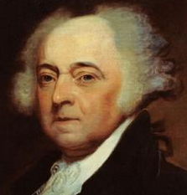
Where is God in Education? http://krisannehall.com/in-context-separation-of-church-and-state/
We can attribute much of what is promoted in our schools today due to the absence of morals and religion in our society, and likewise that mindset percolating into our schools.
Thomas Jefferson said, “Can the liberties of a nation be thought secure when we have removed their only firm basis, a conviction in the minds of the people that these liberties are a gift from God?”
Our founding document, the Declaration of Independence, contains five references to God: “God as the Creator of all men, God as the supreme Lawmaker, God as the Source of all rights, God as the world’s supreme Judge, and God as our Patron and Protector." Let us all become knowledgeable about the fact that the Declaration of Independence is America’s great religious document!
John Adams said, "Our Constitution was made only for a moral and religious people. It is wholly inadequate to the government of any other.”
KrisAnne Hall

Slide 6
How is far-left ideology getting into our schools?
Nationalized one-size-fits all standards- Dumbing-down of all of our children!
Curriculum to match these standards which promote racism, pedophilia, casual sex, LGBTQ ideals, defaming the founders, Anti-American and Marxist sentiments, diversity, social justice, global warming, etc.- the skies the limit on what they will promote!
“Civic Engagement” through school outreach programs- on and off campus!

Slide 7

Dumbed-down English Language Arts (ELA) and Mathematics Standards (aka Common Core) http://www.reynoldsnet.org/commoncore/Top%20Five%20Reasons%20Common%20Core%20Remains%20in%20Arizona.pdf
Common Core English Language Arts (ELA) and Mathematics Standards were renamed or rebranded twice in our state in 2013 (Arizona College and Career Ready Standards) and in 2016 (Arizona K-12 Standards). In 2016, it was done under Superintendent Douglas’ command. Diane Douglas is the Queen of Common Core!
Top Five Reasons Common Core ELA and Mathematics Standards Remain in Arizona:
Developmentally inappropriate standards still exist across the grade levels esp. in K-3rd grade- Standards for Mathematical Practice remain word-for-word and developmentally inappropriate standards still remain throughout the grades. Missing standards throughout ELA and Mathematics standards which were called out by standards experts Dr. Sandra Stotsky, Dr. James Milgram and Ze'ev Wurman. These standards are still missing!
Prescriptive examples on how to solve Mathematics problems esp. in 4th-8th grade now in tables at the front of the Mathematics standards for teachers to use instead of embedded in the standards.
Identical coding remains in Arizona K-12 standards except for a few standards that were added or deleted (5% changes in Mathematics and 7% changes for ELA in K-3rd grade standards).
Standards still poorly written and more confusing in Mathematics according to Dr. James Milgram and Ze'ev Wurman- in K-3rd grade 95% and 93% remain of the Common Core standards for Mathematics and ELA, respectively. Dr. Stotsky's comments were also ignored and not incorporated for ELA. Changing words "for clarity" was the majority of the changes made for the Arizona K-12 Standards.
Majority of Common Core Standards remain, 95% and 93% for K-3rd grade, for Mathematics and ELA, respectively. How could they be renamed to "Arizona K-12 Standards?" Common Core was Rebranded in Arizona a 2nd time on December 19, 2016- Lipstick on the Common Core Pig!

Slide 8
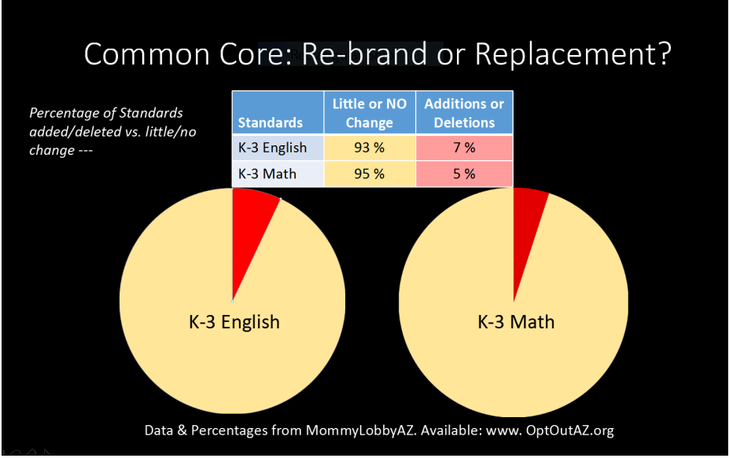
Common Core 2.0 http://www.gilbertwatch.com/index.cfm/blog/a-picture-is-worth-a-thousand-common-core-standards/
Notes:
The numbers do not lie! Common Core has been Rebranded in our state!

Slide 9

Dumbed-down March 2018 Draft History & Social Science Standards http://www.reynoldsnet.org/commoncore/Arizona%20Social%20Studies%20Standards.pdf
Arizona’s Draft History & Social Science Standards are based on a framework developed by the National Social Studies Council called the C3 Framework (https://www.socialstudies.org/resources). This framework is aligned with Common Core and recommends utilizing public schools for “Social Education” and pays homage to John Dewey as this organization believes “teachers can educate for social transformation.” They see education as a weapon for social change, not a tool for success. (https://www.socialstudies.org/node/50751.). Let’s remember who John Dewey was... a Socialist who said, “You can’t make Socialists out of individualists. Children who know how to think for themselves spoil the harmony of the collective society which is coming, where everyone is interdependent.”
What the Arizona Department of Education (ADE) Standards Writing Committee appears to have done is try to be clever and put the teaching about foundational American principals, the Constitution, and the arguments for liberty at the elementary level when they’re too young to understand any of it, and then shift towards Progressive themes as they get to high school.
The Draft Standards particularly when you get to the high school verbiage you begin to see the Progressive themes coming through - the global focus and global citizenship, climate change, revolutionary movements, equating Western and Eastern traditions and cultures, downplaying Christian-Judeo values and teaching other world religions as well as humanism, atheism, secularism, political correctness, etc. There is significant emphasis on current pop culture topics rather than enduring concepts and historical knowledge, which obviously can be extremely opinion based.
Notes:
These History & Science Standards will be voted on in the Fall 2018 by the State Board of Education! These are tied to the ADE’s “Civic Engagement” program as well with same leading both efforts!

Slide 10

Dumbed-down March 2018 Draft Science Standards http://www.reynoldsnet.org/commoncore/Science%20Standards_Executive_summary.pdf
The same framework the Arizona Department of Education (ADE) working groups used to develop the March 2018 draft Science Standards, “Working with Big Ideas of Science Education” and “A Framework for K-12 Science Education,” were the basis for developing the Next Generation Science Standards (NGSS). So, saying these Science standards do not resemble NGSS is just a false statement.
Paul R. Gross stated, “The new [NGSS] standards leave out much important science that has worked perfectly for our students in the recent past....to follow the newest wrinkle in school pedagogy, every standard becomes a performance test, not necessarily on the history, the facts, and big ideas of science, but primarily on the students’ ability to satisfy somebody’s idea of their ‘explanation,’ or ‘modeling,’ or ‘collecting evidence’ skills and the like.” The Scientific Method, for example, no longer exists in these standards which has been a rigorous tool in scientific research for decades. Data cannot be fudged if using the Scientific Method!
Like the Common Core Math Standards these standards are developmentally inappropriate in K-5th grade. Children under 11 years old cannot think “abstractly, persevere when solving problems, or analyze strategically.” These draft Arizona Science Standards are very generic and often delayed on when science topics are introduced, especially in Kindergarten through 5th grade.
Notes:
These Science Standards will be voted on in the Fall 2018 by the State Board of Education!

Slide 11





Examples of Curriculum and Assessments Promoting Far-Left Ideology
Scottsdale Unified School District (SUSD): 50 Myths and Lies That Threaten America’s Public Schools: The REAL Crisis in Education. This book is nothing more than a self-serving piece of political propaganda for the government run school and opposes charter schools, school choice and school vouchers. Outside groups were brought into Scottsdale Middle School to be taught a five week course on Islam that students were not permitted to bring home- this is unapproved curriculum!
Kyrene School District: United Nations Declaration of Human Rights which is taught and promoted to 5th graders.
Tempe Unified High School District (TUHSD): Planned Parenthood FLASH sex education promoting abortion, causal sex, LGBTQ ideals, etc.
Arizona’s Measurement of Educational Readiness to Inform Teaching (AzMERIT) state-wide assessment: Comparing articles and audio calling our form of government a Democracy not a Constitutional Republic. Stating early settlers were not patriotic for cutting down trees to build their homes.
National Assessment for Education Progress (NAEP): Tying man’s use of hydrocarbons to increases in global temperature rises- proven false by countless scientific research!
Notes:
We need to be active in our local school boards and be reviewing textbooks- on-line and hard copy. We are tax payers and we have the right to review how our tax dollars are being spent!

Slide 12

“Civic Engagement” in Schools through Curriculum- Violates the Law! https://www.azleg.gov/ars/15/00511.htm
According to Arizona Law, ARS 15-511, “any employee of a school district or charter school who is acting as an agent of our working in an official capacity for the school district or charter school may not give pupils written materials to influence the outcome of an election or to advocate support for or opposition to pending or proposed legislation.” Violations of this statute are punishable by fines up to $5,000, and violators can be held personal liable to repay misused funds.
SB1009, adopted in 2012, states, “no school district or charter school may endorse or support a program that does not give preference to childbirth and adoption over elective abortion.” Therefore, any Planned Parenthood sex education taught in schools that promotes abortion is against Arizona law!
The Superintendent and Governing Board have the duty to ensure that all activities and all personnel are in accordance with the laws of the State of Arizona, the rules of the Arizona Administrative Code, and the adopted policies of the Governing Board.

Slide 13

ADE “Excellence in Civics Engagement Program” https://www.azed.gov/civicengagement/
The Arizona Department of Education’s (ADE’s) “Excellence in Civic Engagement Program” is cleverly worded but, in truth, is a devious nationally-coordinated political activist program that encourages children to immerse themselves in various social, economic, and political “causes” via youth street activism, political lobbying efforts, community organizing, and connects youth with militant, radical, and political groups.
Among its many politically motivated aims is the goal of lowering the voting age to 16.
The more extensively a school or District weaves this “Civic Engagement” program throughout its curriculum at every grade level, the higher up in ranking the school moves in the ADE awards program. It’s been very well strategized and attempts to use “research” documents to hide its obvious political undertones. It uses not only the terms “Civic Engagement,” but also “Action Civics,” and “Service-Based Learning.”

Slide 14

“Action Civics” not “Old Civics” http://www.usingtheirwords.org/childrens-literature
“Action Civics” is nothing more than youth street activism involving youth in political, social, and economic causes connecting them to the activist political groups at an early age.
It is designed to ensure young people, while they are still impressionable, to become indoctrinated by their “activist teachers,” and by way of their K-12 curriculum.
At an ADE “Civics Engagement” Training session, an outside training group not only provided teachers with curriculum but how to structure their class to push social, economic, and a political agenda. They were told to “start with the (activist) cause because if they tried to start with an academic standard, it would never work.”
This program will be taught during the school day, and teachers were to make sure their students deeply ponder their cause so they connect to it “emotionally and cognitively.” This program is currently being worked into the March 2018 draft History & Social Science standards as we speak by Tammy Waller who is also the coordinator of this ADE “Excellence in Civic Engagement” Program!

Slide 15
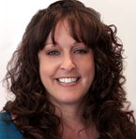


“Civic Engagement” promoted in
Teacher Colleges in Arizona https://education.asu.edu/deborah-ruiz https://education.asu.edu/daniel-dinn-you-liou
Not only does the “Civic Engagement” program affect K-12 schools it is taught at Arizona State University’s (ASU’s) teacher and principal preparation programs.
Deborah Ruiz, ASU’s director of Community Engagement Programs is on the ADE “Civic Engagement Committee” and was one of faculty instructing teachers which said “teachers should start with the ‘activist cause’ because if you start with an academic standard it will never work.”
Daniel Liou, an assistant professor in ASU’s teacher and principal preparation program, is involved in “Teachers 4 Social Justice” which is connected to La Raza. His teaching focuses on “white-serving institutions” and in “making social justice central to their daily responsibilities.”
It would be reasonable to assume similar activist professors are working in teacher preparation programs at NAU and UA as well. I saw many Tier 1 courses in the course catalog at UA very similar to those offered by Daniel Liou at ASU.

Slide 16
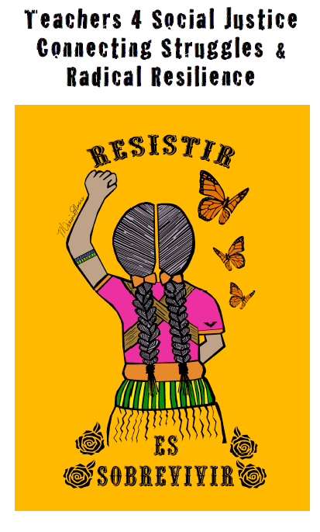
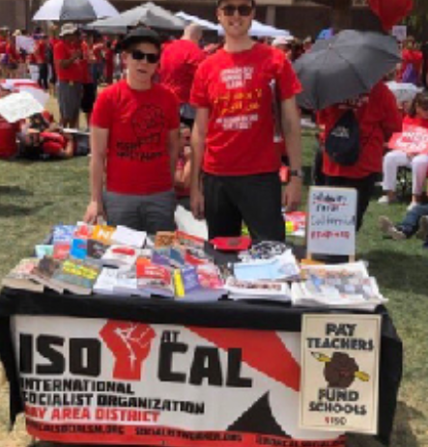

“Civic Engagement” promoted in
Teacher Colleges in Arizona https://t4sj.org
Daniel Liou, with Teachers4Social Justice, hopes to change the “student-teacher-principal” pipeline to harness justice and transform schools and society. The latest Teachers4SocialJustice’s conference discussed “the current corporate agenda as an attack on public education and social justice.”
Some of this year’s teacher training courses at ASU, under Daniel Liou, is intended for middle school and high school children include- “What’s Your Gender Story?; Curriculum and Pedagogy with White Teenagers; Teaching Justice in the Academy; etc.” More course descriptions here: https://teachers4socialjustice.files.wordpress.com/2017/10/t4sj-2017-conference-program-10-4-20172.pdf

Slide 17


“Service Learning” in State Standards
“Service Learning” programs are promoted by the Arizona Department of Education and they are integrated into the March 2018 Draft History & Science Standards. These programs teach a specific ideology and they are designed to mobilize students to put that ideology into practice.
Getting out the vote programs; street protests; lobbying your legislators; and Anti-gun protests on school grounds are all political and against the law! Indoctrinating students for them to then put these ideas into practice is not education – it is recruiting political acts and most certainly is NOT the purpose of taxpayer funded schools!
Why are our children marching and protesting in the streets instead of learning in the classroom reading classical literature, civics, math, science, etc.?

Slide 18
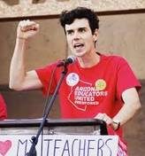

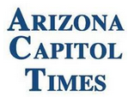
Red For Ed, or Just Plain Red?
“Arizona Capitol Times- Yellow Sheet Report”
Arizona Educators United (AEU) leader Noah Karvelis spoke at the International Socialist 2018 Conference in Chicago over the July 4th holiday. Karvelis recounted how the #RedForED movement grew in Arizona and how AEU grew from a Facebook page to an organization of around 60,000. He said, “What we did is we said we’ve had enough. Forget about the rules. We’re making our own rules. We’re standing up and we’re fighting back. And that’s what Arizona Educators United, and each one of these movements, truly says. It’s time for us to take control.”
Karvelis also said, “The movement created an organization with 2,000 experienced leaders that will continue to influence politics in Arizona. We’ve built a new organization and new political power in Arizona, and it’s taking control right now of the future of the state.”
AEU’s latest initiative is to double the income taxes for all small businesses or families making over $250K, through a ballot initiative in November, and this will ruin the economy of Arizona! Even the left-leaning, Arizona Chamber of Commerce has criticized Karvelis and have recently said, “Comrade Karvelis is the leading agitator behind the initiative campaign to double the income tax on small business.” Jaime Molera, former State Board of Education Member and leader of Arizonans for Great Schools and a Strong Economy stated, “Our tax and education laws should be crafted with Arizona’s children, families and economic health as the beneficiaries, not socialist dogma.” VOTE NO on the “Invest in Education” proposition in November!
Notes:
VOTE NO on the “Invest in Education” proposition in November! “Radical Soak the Rich Initiative will Derail Arizona’s Economic Recovery:
https://www.azfree.org/radical-soak-the-rich-initiative-will-derail-arizonas-economic-recovery/

Slide 19
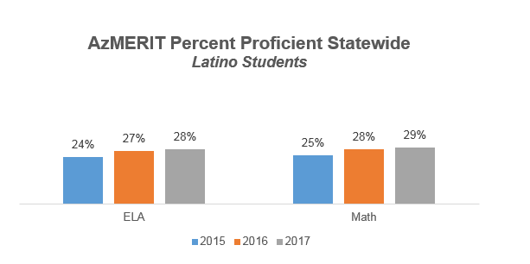
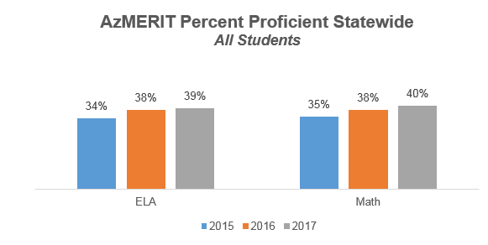

So how are Arizona Children Performing?
AzMERIT Assessment Results http://www.helios.org/blog/recent-azmerit-scores-show-incremental-positive-gains
Statewide proficiency showed incremental gains since the test was first administered in 2015. For example, the percent of students meeting proficiency statewide in math and ELA increased by five percentage points in both subjects over the three testing years.
Vince Yanez, Senior Vice President, Arizona Community Engagement for Helios Education Foundation. “We are encouraged to see some incremental growth in the proficiency of Latino students, but we still have significant work to do to close the gap. With Latino students making up the largest percentage of our K-12 population, it is critical that we have a laser focus on closing the achievement gap to ensure a strong future for Arizona.”
Another area that Helios monitors closely is third-grade reading rates. In 3rd grade English Language Arts, 44% of students achieved proficiency, four points higher than in the test’s 2015 inaugural year. Proficiency in third grade reading is highly predictive of success in later grades as well as high school graduation and postsecondary education.

Slide 20
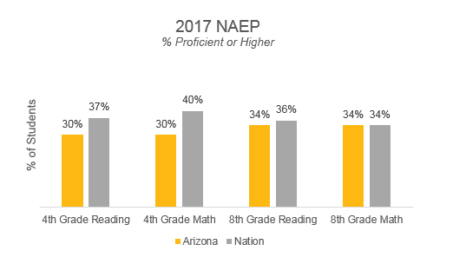
Arizona Student Test Scores Remain Stagnant in National Assessment http://www.helios.org/blog/arizona-student-test-scores-remain-stagnant-in-national-assessment
With the exception of 8th grade math, Arizona continues to lag behind the nation in terms of the percent of students achieving a score of proficient or higher. Based on most recent results, the percent of 4th and 8th grade students in Arizona and nationally scoring at or above proficient in reading and math are as follows:
Notes:
Look what these dumb-down standards, assessments and “civics engagement” have done for student performance. We continue to lag behind.

Slide 21
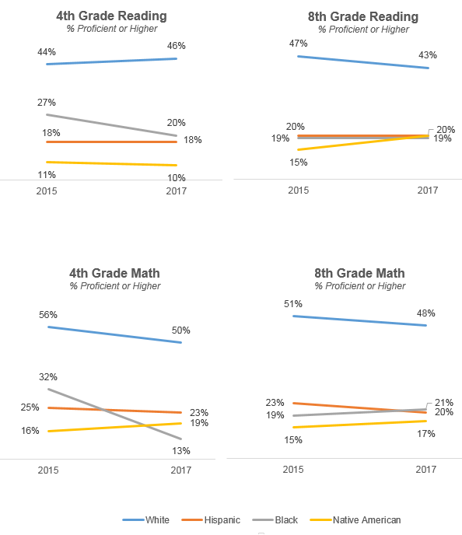
Arizona Student Test Scores Remain Stagnant in National Assessment http://www.helios.org/blog/arizona-student-test-scores-remain-stagnant-in-national-assessment
When examining the percentage of Arizona students scoring proficient or higher by race/ethnicity, most groups showed declines across both subjects and grades from 2015 to 2017. Black students experienced the steepest drop in proficiency rates in 4th grade reading and math. Furthermore, White students continued to outperform their minority peers with little to no progress in closing achievement gaps. In addition, it should be noted that Arizona continues to see an upward trend in overall growth when compared to other states, however, we still have significant work to do to ensure our students reach higher levels of proficiency in math and reading.

Slide 22
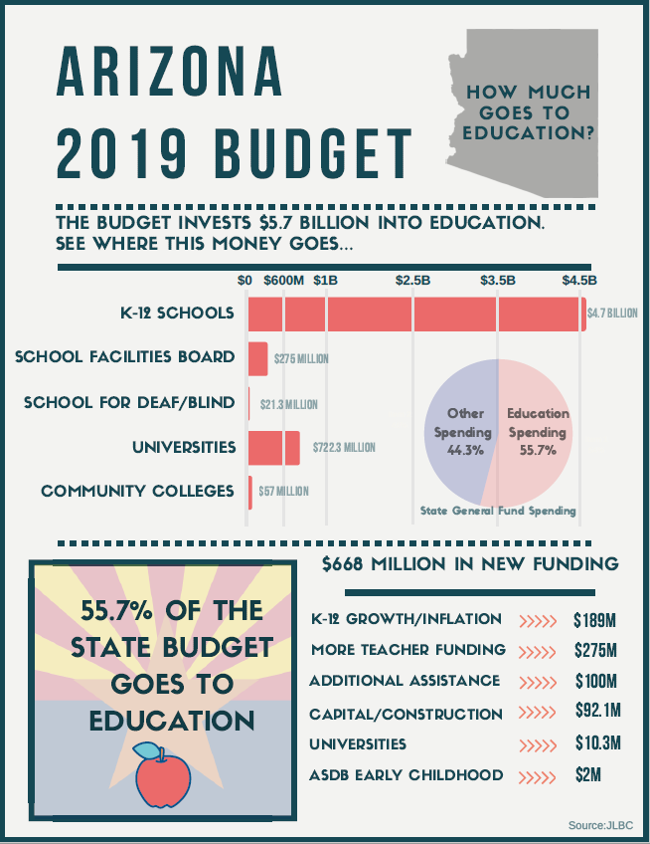

How much of the Arizona State budget goes to Education? https://www.azleg.gov/jlbc/budgetupdates.htm
Joint Legislative Budget Committee (JLBC)
Notes:
After Red4Ed Marches in 2018, this is the new 2019 Education Budget. More money will not solve the education crises in Arizona or across the nation!

Slide 23
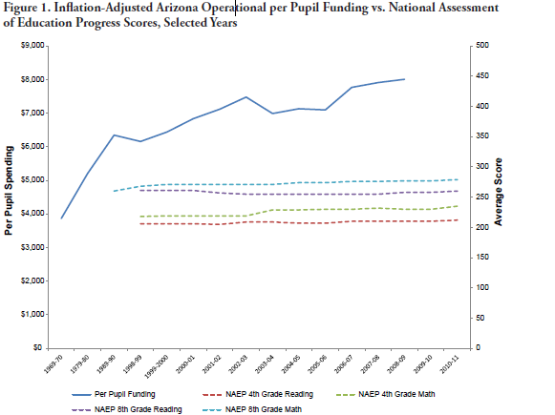
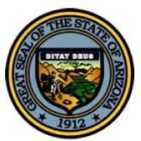
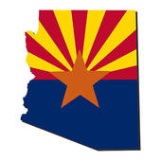

Has more Federal and State Money spent made our students smarter over the years? No!
Source: National Center for Education Statistics (NCES), “Digest of Education Statistics: 2011,” Table 194, http://nces.ed.gov/programs/digest/d11/tables/dt11_194.asp
Notes:
I kept this graph in my presentation as well to show you that increases in federal funding for federal programs does not equate to “higher achievement” in students. As seen from this graph, despite more money spent, year after year, we have not seen an improvement in the National Assessment of Education Progress Scores for 4th and 8th grade Reading and Math in Arizona! Returning to “local control,” which is constitutional, will improve student achievement!

Slide 24
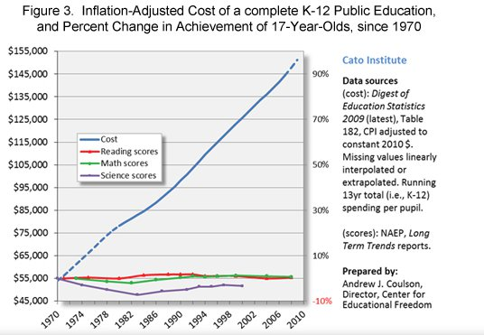

CATO Institute Study: “Inflation-Adjusted cost of a complete K-12 education vs. NAEP scores” http://www.cato.org/publications/congressional-testimony/impact-federal-involvement-americas-classrooms
Review this graph from the CATO Institute which shows an exponential increase in money spent to complete a K-12 Public Education from 1970 through 2010 versus the National Assessment for Educational Progress (NAEP) test scores which remain flat.
So there is no proof that spending more money on education guarantees an improvement in assessment scores by our students! What happens in the classroom and what is being taught in the classroom through a "classical education" with the curriculum that is selected, AND is backed up through parental involvement, is the "key" to a good education.
Notes:
Here is a national graph of Inflation-Adjusted cost of a complete K-12 Education vs. NAEP scores. There is no proof that spending more money on education guarantees an improvement in student achievement on assessments!

Slide 25

What Can You Do?
Educate yourselves on our founding documents. Many on-line resources available to do this. Share what you have learned with others in your community. Save our Constitutional Republic by educating ourselves and others!
Support local control over education not federal control. Research the candidates (local and federal) before you vote at the ballot box. Where do they stand on education? Do they support parental rights? For those up for re-election how did they vote in the past?
Attend your local school board meetings. Track how they are voting and what they support. Speak at their meetings on what concerns you in your district. There is power in numbers!
Watch or attend the monthly State Board of Education meeting. These are the “education policy makers” in our state. (https://azsbe.az.gov/public-meetings)
Ask to view all textbooks (curriculum)- hard and soft copy. Your tax dollars fund your local schools and you have the right to view any textbooks they are using to teach our children. Even if you do not currently have a child in that district. You can find out where your tax dollars are spent by your property tax statement from the Treasurer’s office.
Comment on bills at the Arizona State legislature. Create a “Request to Speak account” so you can comment on bills from home or testify on bills in person. (https://apps.azleg.gov/Account/SignOn)
Know who your state and federal representatives are and be in continual communication with them. If you do not like how they are voting let them know. Also, send them words of encouragement when they are doing well and listening to their constituents! (https://www.govtrack.us/congress/members)
Comment on our state standards and let the Arizona Department of Education (ADE) know we do not support the dumbing-down of our children or teaching far-left ideology in our standards: http://www.azed.gov/standards-practices/
Join “Mommy Lobby AZ” and help us in the fight to restore local control over education. E-mail: AzSchoolChoice@cox.net or Follow us @MommyLobbyAZ
Share this presentation with your communities. Available at: http://www.reynoldsnet.org/commoncore/news.html
Mommy Lobby AZ
Action Items!
Notes:
Save our Constitutional Republic and our children by being active in your communities!

Slide 26
Any questions?
Contact me any time with your questions at Azschoolchoice@cox.net.
Mommy Lobby AZ

