Slide 1

Education Update- August 2015
Presenter- Jennifer Reynolds

Slide 2
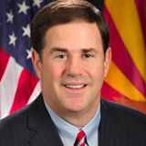
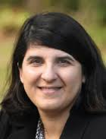
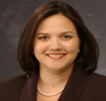

Arizona Standards Development Committee
Initiated by the Governor’s office and tasked to the State Board of Education (SBE) to develop a policy to “Review and Replace Common Core” on 3/23/15. NOTE: SBE policy was written by Executive Director Christine Thompson and the Governor’s Education Policy Advisor Dawn Wallace and presented at the SBE meeting on 4/27/15.
On 4/28/15, a meeting was held with Governor Ducey and his staff, and with our “mommy lobby” from “Arizonans Against CC” and “Opt Out AZ” to discuss this new process, and to ensure our involvement in “Replacing Common Core.”
The 17-Member “Arizona Standards Development Committee” was selected on 5/13/15 and announced at the SBE meeting on 5/18/15 (members next slide).

Slide 3

Arizona Standards Development
Committee Members (17) http://www.gilbertwatch.com/index.cfm/blog/arizona-standards-development-committee-members-chosen/
Four members of the State Board of Education (SBE):
  President SBE Greg Miller
  SPI Diane Douglas
  Jared Taylor (Elected as Vice-Chairman on 6/24/15)
  Chuck Schmidt
Two members from the business community:
  Maureen Tozzi- Sales and Marketing, Tucson
  Dr. Richard Rutowksi- Family Medicine Doctor, Fountain Hills
Three Deans of Colleges of Education or directors of Board-Approved teacher preparation programs, with at least one representative of an institution under the jurisdiction of the Arizona Board of Regents, and one representative of an institution under the jurisdiction of an Arizona Community College:
  Dr. Mari Koerner, ASU Dean of the Mary Lou Fulton Teachers College
  Dr. Nora Reyes, Mesa Community College Dean of Education
  Dr. Karol Schmidt, Grand Canyon University Associate Professor and Program Division Lead
Three parents- including one each from Elementary, Middle or High School age child:
  Olga Tarro- Oro Valley (Elementary School parent)
  Grant Peterson-Gilbert (Middle School parent)
  Dexter Albert- Flagstaff (High School parent)
One Elementary Classroom Teacher:
  Jan Ogino, Marshall Ranch Elementary, Peoria Unified
One Secondary Classroom Teacher:
  Christine Marsh, Chaparral High School English Teacher, Scottsdale Unified School District
One administrator of an Arizona Charter School:
  Dr. Lynn Robershotte, Eduprize Schools
One administrator of an Arizona Unified School District:
  Dr. Matthew Strom, Chandler Unified School District (CUSD)
One member from School District Governing Board: (Elected as Chairman on 6/24/15)
  Scott Leska- Amphitheater Unified School District, Tuscon
Notes:
There are 3 parent representatives on this committee. Jared Taylor and Chuck Schmidt from the SBE do not support Common Core.

Slide 4

Arizona Standards Development Committee (cont..)
The “Arizona Standards Development Committee” has conducted two meetings thus far- one on 6/24/15 to develop the organization structure, and one 8/3/15 to vote on the members selected for the English Language Arts (ELA) and Mathematics Subcommittees (15 members each). These Subcommittee members were selected through an application process and teacher database conducted by the Arizona Department of Education (ADE) under the direction of Carol Lippert. Everyone who applied was given a rubric score and those who scored above a 6 were evaluated further until the master list was narrowed down. There will be a grade-level lead for ELA and Mathematics Subcommittees (next slide).
Technical Experts will be working with the ELA and Mathematics Subcommittees to “Review and Replace Common Core” through the “Standards Review and Revision Working Groups” and hopefully parents as well! Some of these technical experts will include Dr. Sandra Stotsky and Dr. James Milgram. More experts are still yet to be chosen.
The new “Arizona Standards” that are being written through this process are supposed be reviewed, with public input, and be completed by the end of the 2015-2016 school year.
When will new the “Arizona Assessment” be written to match these new “Arizona Standards?” Will schools be given the freedom to choose their own assessment that matches their curriculum- a Menu of Assessments? This is what we are pushing for in our organization- a “Menu of Assessments bill given schools the freedom to choose the assessment that works best for their curriculum.
Notes:
This was a very complicated process on how each person was scored under the ADE’s rubric. Those above 6 moved forward in this process and then each were narrowed down to just one person per grade level or subject for ELA and Mathematics.

Slide 5
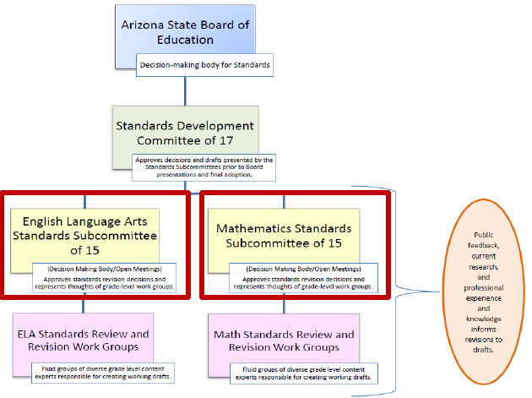

Arizona Standards Development Committee (cont..) https://azsbe.az.gov/public-meetings (June 24th- Arizona Standards Development Committee Agenda)
Organization structure voted on at 6/24/15 meeting.
Notes:
This is the organization structure that was voted on by the “Arizona Standards Development Committee” at the 6/24/15 meeting.

Slide 6
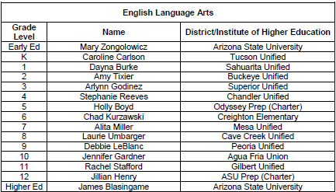
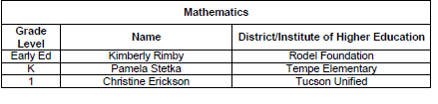
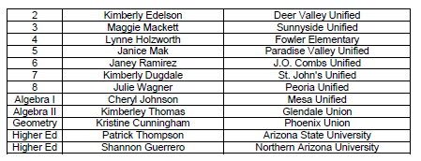
ELA and Mathematics Subcommittee Members
All Subcommittee members selected had to have the following criteria:
Be a resident of Arizona.
Currently employed or a retired teacher from an Arizona public school (district, charter or county Education Service Agency)
Holds a valid Arizona teaching certificate.
Has 3 or more years of documented teaching experience.
Early Ed slot was removed through a 9-7 vote. There are no “Early Education” standards (aka Common Core pre-K) which was brought up by Superintendent Douglas.
More background needed in “higher mathematics” beyond Algebra II for new “Arizona Standards.” Mike Robinette- AP Calc Teacher with Algebra II background was voted to replace Algebra II person. He is a teacher in the Amphitheatre Unified School District (Ironwood High School in Tucson).
Notes:
Superintendent Douglas requested an amendment to remove Early Education slots for ELA and Mathematics since there are no “Arizona College and Career Ready Standards” for Pre-K. Motion passed 9-7. Another amendment was proposed by Jared Taylor to change ELA Grade 10 slot to Claire Morgan (Tucson Unified School District) and Mike Robinette for Algebra II/Pre-calc slot (Amphitheatre Unified School District). Only
Mike Robinette’s slot proposal passed.

Slide 7

AzMERIT “cut scores” set for parent reports http://www.arizonansagainstcommoncore.com/AzMERIT_Facts.pdf
The State Board of Education (SBE) voted unanimously on 8/14/15 to approve the “cut scores” for AzMERIT’s ELA and Mathematics parent report. These are the scores your child have to score above to be considered “proficient” in ELA or Mathematics. (This was “Meets” previously with the AIMS assessment).
These “cut scores” will be published on the new AzMERIT parent reports and will be submitted to schools and parents at the end of October (see sample parent report on subsequent slides).
I testified and opposed this measure being voted on since AzMERIT was never a “validated” assessment- it was never field tested with a small group of children before being given to 750K students. This test cannot be called an “Arizona” test because the test modules for AzMERIT were purchased from Utah’s SAGE test in December 2014. AzMERIT was hurridly adopted and implemented in a mere 21 weeks which gave no time for validation test to prove it will “assess what it claims to”- Arizona’s College and Career Ready Standards (aka Common Core Standards).
This process will have to be repeated all over again when the new “Arizona Standards” are completed at the end of the 2015-2016 school year. The statewide assessment AzMERIT will not match the new standards so a new assessment will need to be written and validated.
There are no school report cards (letters grades given to teachers and schools based on how their students perform on the statewide assessment) due to SB1289 for the 2015-2016 school year as well, so what is the rush to approve “cut scores?”
So my plea with the SBE was for them to pause and really evaluate approving cut scores for AzMERIT when we don’t know if this assessment is “valid,” and they would have to repeat this process all over again in another year with new standards and a new assessment. I was the only parent who spoke and my comments were ignored and the “cut scores” were approved!

Slide 8
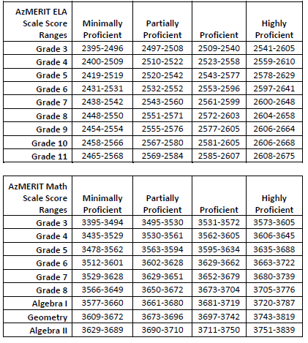
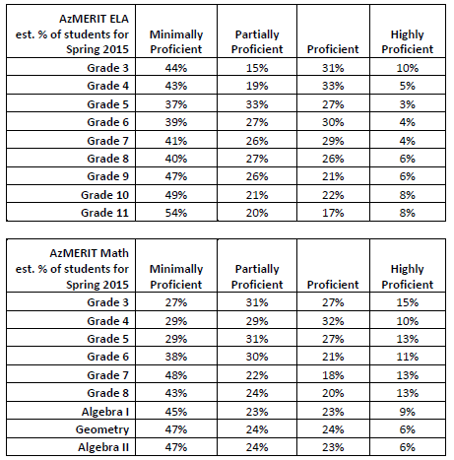
AzMERIT “cut score” ranges and performance percentages
59%-70% will be “below proficient” for ELA
56-71% will be “below proficient” for Math
The ADE recommended that the SBE adopt these performance ranges based on a study that was done by the “AzMERIT Standards Setting Panelists” which included representatives from American Institutes for Research (AIR), teachers and school administrators (81 members). The SBE voted unanimously to accept these “cut scores” for the AzMERIT assessment that has never been “validated!”
Notes:
The “cut score” ranges were extrapolated from the 2012 AIMS assessment data on how our students performed and based upon how students from other states have scored with SBAC. ACT scores were also considered in this extrapolation but I have to “scratch my head” on how that was incorporated based upon a “college readiness” score on the ACT or a score of 22. Representatives from American Institute for Research (AIR), teachers and administrators performed this analysis at the “AzMERIT Standards Setting Workshop” in which 81 people were in attendance. I have to ask again, “Isn’t this data completely useless if AZMERIT was never validated?” Aren’t we traumatizing students who normally do well in school with a “false message” that now they will be considered “not proficient” on AzMERIT? For what purpose?! This entire process will be meaningless in another year with new “Arizona Standards!” This is a great way to waste our taxpayer dollars and traumatize our children! It’s all about “data mining” and NOT about improving student achievement!

Slide 9
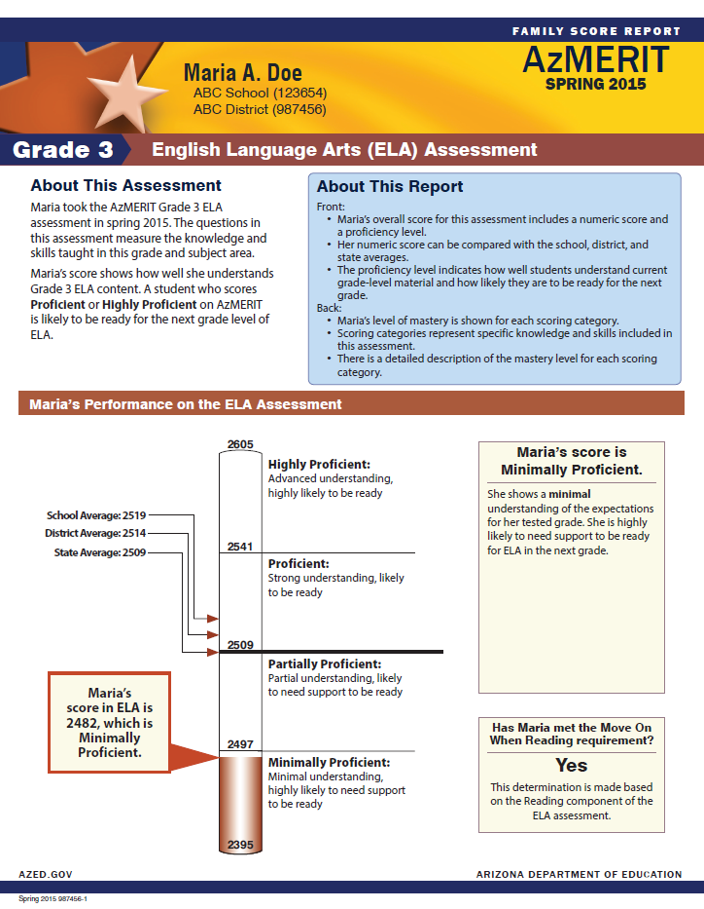

AzMERIT sample parent report- “Family Score Report”
Notes:
The “proficient” cut scores vary based on grade levels and also on subjects for ELA and Mathematics, respectively. This will be the front page of the “Family Score Report.”

Slide 10
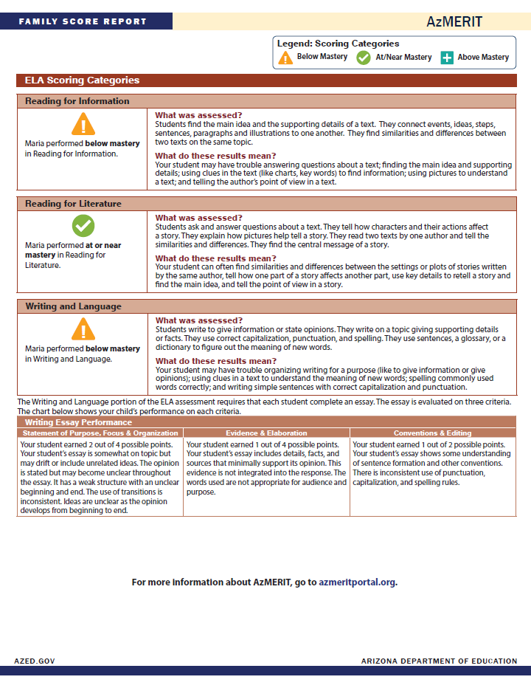
AzMERIT sample parent report- “Family Score Report” (cont..)
Notes:
This are notes that will be given on your children explaining areas of improvement.

Slide 11
Title 15 Working Group http://www.azed.gov/public-relations/files/2015/06/061815-title-15-working-group-release.pdf
This group is tasked to evaluate Arizona Revised Statute (ARS) Title 15 (which covers most of the education policies and duties of districts and charters schools in Arizona), and to deregulate or “remove laws” in order to reduce the burdens on schools. We are told to ask these questions: “How does this law help kids? Is it required? Or does it increase student achievement or improve accountability?”
This is a 15-member volunteer group (see next slide) that will prioritize items we suggest, or those submitted by the public, and number them #1-30. All of these suggestions will be deliberated further as a working group and then submitted to Superintendent Douglas and the Arizona Legislature as bills to change Title 15.
There are 3 lawyers in the working group that will be drafting up our proposed changes into bill format- Thomas Pickrell (Mesa Public Schools), Todd Jaegar (Amphitheater Unified School District- Tuscon), and April Hamilton (Associate Attorney at Ridenour, Hienton & Lewis law firm)
We’ve had two meetings thus far on July 8th and August 11th. Five items have been reviewed thus far and more will be tackled at subsequent meetings. These meetings are not subject to “open meeting laws” but the public can submit comments at anytime to PolicyInbox@azed.gov.
My #1 goal serving as your “parent representative” in the Title 15 Working Group is to ensure parental rights are supreme!
This process should be completed by the end of October.
Title 15 will be re-evaluated on a yearly basis under Superintendent Douglas.

Slide 12

Title 15 Working Group Members http://www.azed.gov/public-relations/files/2015/06/061815-title-15-working-group-release.pdf
Ernest Calderón (Chairman)- President Emeritus of the Arizona Board of Regents & Partner in Ridenour, Hienton & Lewis law firm providing expertise in education law (Policy Representative).
Kevin Hegarty (Vice Chairman)- Executive Director of Business and Operations at Laveen Elementary School District (Business Operations Representative).
Erica Avila Hlavaty- Director of Student Services focusing on transforming the special education program at Isaac School District (Special Education Representative).
Jeremy Calles- CFO at Kyrene Elementary School District (School Finance Representative).
Jeanne Casteen- Member of Creighton School District Governing Board & current teacher at North High School (Teacher & School Board Member Representative).
April Hamilton- Associate attorney at Ridenour, Hienton & Lewis law firm practicing in the area of education law (Policy Representative).
Ricardo Hernandez- Deputy County School Superintendent and CFO at the Office of the Pima County School Superintendent (County Representative).
Todd Jaeger- Associate Superintendent and General Counsel and Executive Director of Human Resources at Amphitheater Unified School District (Support Services Representative).
Jody Johnson- Founder & CEO of Pointe Charter Schools (Charter School Representative).
Dr. Quinn Kellis- Superintendent of Madison School District (Superintendent Representative).
Bill Maas- Retired Associate Superintendent of Fiscal Services for Deer Valley Unified School District (Superintendent Representative).
Dr. David Peterson- Superintendent of Scottsdale Unified School District (Superintendent Representative).
Thomas Pickrell- General Counsel for Mesa Public Schools (Large District & Legal Representative).
Jennifer Reynolds- Parent of four school aged children (Parent Representative).
Carol Weekly- Director of Child Nutrition at Queen Creek Unified School District (Health & Nutrition Representative).
Travis Zander- CFO at Agua Fria Union High School District (High School & School Finance Representative).

Slide 13
“The National Common Core System” document delivered to legislators- We need your help following up!
Our “mommy lobby” from “Arizonans Against Common Core” along with American Principles Project wrote “The National Common Core Standards System” document to educate the Governor’s staff; our Superintendent of Public Instruction; the legislature; local school boards and charter school governing bodies; and “We the People of Arizona” on the “Common Core System= Standards + High-Stakes Testing+ Data Mining.”
Hard copies were delivered in July 2015 to the Governor’s staff, Superintendent Douglas, the House Education Committee Members, the Senate Education Committee Members, and Republican leadership in the House and Senate.
Soft copies were delivered to all of the 90 legislators in August 2015 to educate them on the Common Core System and to increase support for our Common Core bills in the 2016 legislative session.
We need your help visiting your legislators in Legislative Districts 1-30, your local school boards, and charter school governing bodies promoting this document and ensuring they read it! We need you to become familiar with this document so you can emphasize what aspects are important to you- data mining is the driving force behind Common Core!
Lisa Fink and I will be visiting the Chambers of Commerce Education Policy Advisors starting in Glendale and hopefully others before the next legislative session. The Chambers of Commerce have been very influential and spreading “false narratives” in support of Common Core. Some of our legislators listen to the Chambers of Commerce, funded by the Gates Foundation, instead of “We the People” because they have been backed heavily by the Chambers in their election campaigns. We hope to “turn the tides” of this narrative in the Chambers and counteract their efforts. Exposing “data mining” is a great way to do this!
Action Item!

Slide 14



Definitions- Aggregated Data vs.
Personally Identifiable Information (PII) http://www.ed.gov/programs/titleiparta/reportcardsguidance.doc
Data is being collected on our children and shared with “outside entities” for research and with the federal government.
Aggregated Data Definition- data that is summarized in groups for statistical purposes. Under No-child-left-behind (NCLB), “all States and Local Education Agencies (LEAs) must collect and report information on their academic assessments in reading/language arts and math (and science beginning in 2007-08), AYP results, and teachers’ qualifications. Many of these data elements must be disaggregated by Federally-defined subgroups, necessitating the collection of student demographic information. A full discussion of Federal NCLB Report Card requirements can be found in non-regulatory guidance issued on September 12, 2003 by the U.S. Department of Education.” This data can include a student’s school, identification number, family contact information, test scores, report card, etc. Now NCLB= The Elementary and Secondary Education Act (ESEA).
Personally Identifiable Information (PII)- is information that can be used on its own or with other information to identify, contact, or locate a single person, or to identify an individual in context. This data is a “personal identifier” which can include, but is not limited, to: a student’s school, identification number which is tied to the following: vaccination records; a social security number; birth place; mother’s maiden name; a “biometric record” (a record of one or more “biological” or “behavioral” characteristics that can be used to recognize an individual. For instance, a psychologist’s behavior evaluation, fingerprints, iris and retina scans, facial recognition, voice prints, handwriting samples, etc.); school surveys; etc.
Notes:
These are the definitions for “Aggregated Data” vs. “Personal Identifiable Information” (PII) data.

Slide 15

Definitions- Data Mining, Affective Domain and Statewide Longitudinal Data Systems (SLDS) http://serc.carleton.edu/NAGTWorkshops/affective/intro.html http://www.newswithviews.com/Hoge/anita108.htm
Data Mining definition- the process of collecting, searching through, and analyzing a large amount of data in a database, as to discover patterns or relationships. Under Common Core it is used to determine a “career path” or “human capitol” for a “career-to-work.”
Affective Domain definition- creating psychological profiles and molding "human capital" with values, beliefs and dispositions without parental or student knowledge or consent. The federal government now wants “to use schools to catalogue attributes, dispositions, social skills, attitudes and intrapersonal resources independent of intellectual ability,” all under the guise of education. (http://www.ed.gov/edblogs/technology/files/2013/02/OET-Draft-Grit-Report-2-17-13.pdf ) The Statewide Longitudinal Data System (SLDS) is an integral tool tying the Common Core Standards with the Common Core assessments (AzMERIT, PARCC, SBAC, etc.) and the “politically correct” curriculum.
Statewide Longitudinal Data Systems- A Statewide data system that reports aggregated and PII data to the federal government. Funding is contributed to the state to establish the “data framework” and “data reporting structures” through federal grants and through local legislative budgets.

Slide 16

“It’s My Personally Identifiable
Information (PII)” http://itsmypii.com/
This is a new organization started in July 2015 to stop personally identifiable information (PII) from being shared with the federal government or “outside entities” for research.
The Federal Educational Rights and Privacy Act (FERPA) was stripped with EO 12866 under the Clinton administration and further codified through funding through the American Resource and Recovery Act (ARRA) under the Obama Administration. (https://nces.ed.gov/programs/slds/state.asp?stateabbr=AZ)
PII data is collected from your child through parental forms, surveys, psychological evaluations, assessments, etc., and posted in the AZ Dash database where the Statewide Longitudinal Database System (SLDS) also resides. (http://www.azed.gov/aelas/az-dash/)
SLDS data is shared directly with the federal government and is linked to the Department of Labor’s “school-to-work” databases without parental consent. (http://www.gao.gov/assets/670/667071.pdf)
Our state is 50% complete with the SLDS framework as compared to other states (http://dataqualitycampaign.org/wp-content/uploads/files/pdf/stateprofiles/AZ.pdf). For more information read through the “Our Children Are Not For Sale” PowerPoint presentation on our website: http://www.arizonansagainstcommoncore.com/news.html
Any company can request your child’s data from a simple form at the ADE- Aggregated or PII data: http://www.azed.gov/data/data-requests-2/
“It’s My PII” is filing a civil injunction against the federal Department of Education, and any other federal or local department from sharing PII student data without parental consent. This injunction will also block the transmission of student data to “non governmental” agencies that use this data for research without parental consent. This injunction will help to solidify parental rights which are already outlined in our Arizona State Constitution in 1-601 and 1-602. The AzMERIT assessment is also part of this injunction and will stop this assessment until it is proven to be validated and it has been verified that it contains no capability to collect any information.

Slide 17
“It’s My Personally Identifiable
Information (PII)” {cont…} http://itsmypii.com/
What can you do? The “core” of Common Core is data collection. Superintendent Diane Douglas was elected with a clear mandate to eliminate Common Core and move Arizona K-12 education to “state control over standards” and “state protection of parental rights and student data.” We need your help by:
  Join us the effort by visiting www.ItsMyPII.com. Pass the web site with this message on to your email lists and friends as well!
  Tell your friends and every parent you know about what is happening to their children and their authority to object. Explain to them that education is -in fact- the civil rights issue of our time.
  Consider hosting a small group event to explain the importance of protecting parental authority and personally identifiable data.
  Consider a gift of $5, $10, $20 or more to the fundraising effort to get to our first goal of $30,000.00- this is the cost of the attorney retainer and filing the injunction.
  The entire effort is likely to cost $250,000.00 or more. Once the injunction is filed this effort will catch the eye of the national news media and we should see a good response to help Arizona fight this for all other states.
“It’s My PII” has invited a number of organizations to join them in this fight. Later this month Rep. Finchem will fly to Washington D.C. to meet with such organizations as the Family Research Council, Freedom Works and others to appeal to them for help. The 10th Amendment Center and many TEA Party organizations across the state are now working to get the word out about this endeavor.
Rep. Finchem is available to speak to any group and I highly encourage you to take him up on this offer. Contact him at (602) 926-3122 or MFinchem@azleg.gov
Action Item!

Slide 18
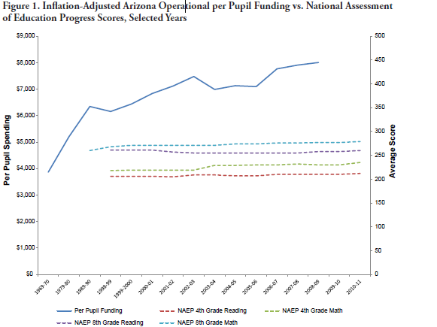


Has more Federal and State Money spent made our students smarter over the years? No!
Source: National Center for Education Statistics (NCES), “Digest of Education Statistics: 2011,” Table 194, http://nces.ed.gov/programs/digest/d11/tables/dt11_194.asp
Notes:
I kept this graph in my presentation as well to show you that increases in federal funding for federal programs does not equate to “higher achievement” in students. As seen from this graph, despite more money spent, year after year, we have not seen an improvement in the National Assessment of Education Progress Scores for 4th and 8th grade Reading and Math in Arizona! Returning to “local control,” which is constitutional, will improve student achievement!

Slide 19
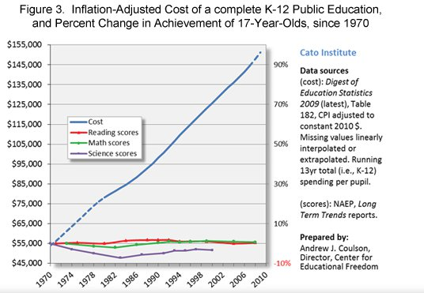

CATO Institute Study: “Inflation-Adjusted cost of a complete K-12 education vs. NAEP scores” http://www.cato.org/publications/congressional-testimony/impact-federal-involvement-americas-classrooms
Review this graph from the CATO Institute which shows an exponential increase in money spent to complete a K-12 Public Education from 1970 through 2010 versus the National Assessment for Educational Progress (NAEP) test scores which remain flat.
So there is no proof that spending more money on education guarantees an improvement in assessment scores by our students! What happens in the classroom and what is being taught in the classroom through a "classical education" with the curriculum that is selected, AND is backed up through parental involvement, is the "key" to a good education.
Notes:
Here is a national graph of Inflation-Adjusted cost of a complete K-12 Education vs. NAEP scores. There is no proof that spending more money on education guarantees an improvement in student achievement on assessments!

Slide 20

What Can You Do? http://arizonansagainstcommoncore.com/Common_Core_Action_Items.pdf
Work to stop the Reauthorization of The Elementary and Secondary Education Act (ESEA- formerly No-child-left-behind) by contacting your Congressman:
  Contact your two State Senators- John McCain and Jeff Flake and demand they VOTE NO on HR5! (Student Success Act- This already passed in the House on 7/8/15 with a 218-213 vote and 3 not voting. This bill increases Title 1 Portability for all schools and further tightens the federal governments grip on schools through Title 1mandates- 95% participation rate on statewide assessments, reporting graduation rates, 2-yr trend data, etc.).
  Contact your one Congressman and demand he/she VOTES NO on S. 1177! (Every Child Achieves Act- This already passed in Senate on 7/16/15 with a 81-17 vote and 2 not voting. This bill requires all States to have “State Education Plans” approved by the federal government which further solidifies Common Core.)
Encourage our Arizona Legislature to draft and support legislation that protects our student data from being shared with the federal government AND “outside entities;” and legislation that allows parents to “opt out” of AzMERIT! Encourage our Arizona Legislature to draft legislation to “Get us Out” of the Statewide Longitudinal Data Systems (SLDS)!
Donate to “It’s My PII” and join their organization to stop PII data: http://itsmypii.com/
Contact Superintendent Diane Douglas and demand that her department not share any student data, including aggregated and personal identifiable information (PII) data, with “outside entities” without parental consent!
  Contact Superintendent Douglas by e-mail and phone: Diane.Douglas@azed.gov or 602-542-5423.
Fill out “Opt Out” forms for the AzMERIT assessment from “OptOutAZ.org”: http://www.optoutaz.org/print-opt-out-forms/
Join “Arizonans Against Common Core” and “Opt Out AZ” so you can know what other action items to take to “Restore Local Control” by stopping the “Common Core System”= Common Core Standards + AzMERIT assessment + Data Mining! E-mail: AzSchoolChoice@cox.net and Gina@OptOutAZ.org
Educate your legislators, local school board members and charter school governing bodies on “The National Common Core Standards System” document.
Share this presentation with your communities and your legislators- Available on the website at: http://arizonansagainstcommoncore.com/news.html
Action Items!
Notes:
So is there ANYTHING we can do to stop “The Common Core System= Standards + High-Stakes Testing + Data Mining?” YES there is, review our “Common Core Action Items” flier today!

Slide 21

Parental Rights Rally-
October 17, 2015, 10:30am-12pm
Arizona State Capitol South Lawn
Notes:
This is your opportunity to be heard and share experienced with other Common Core Fighters across the state!

Slide 22
Any questions?
Contact me any time with your questions at Azschoolchoice@cox.net.

